Slide 1
Capstone Rides Data Analysis

Slide 2
Objective
RIDE IT is the multi-service mobility company.
Objective is to draw insights to identify trends and patterns and find the key metrics from the provided data to propose better driver’s engagement.

Slide 3
Exploratory data analysis
We have data for two countries Germany(DE) and Spain(ES).
Total: 36972 drivers.
PHV: 5,651(15.28%) and TAXI: 31,321(84.72%).
Over 71% drivers have chosen marketing notifications from DE and ES.
23,505(63.58%) drivers are into gold level.
Top 10 gold level drivers are from Germany(DE).
Germany has highest rides %.

Slide 4
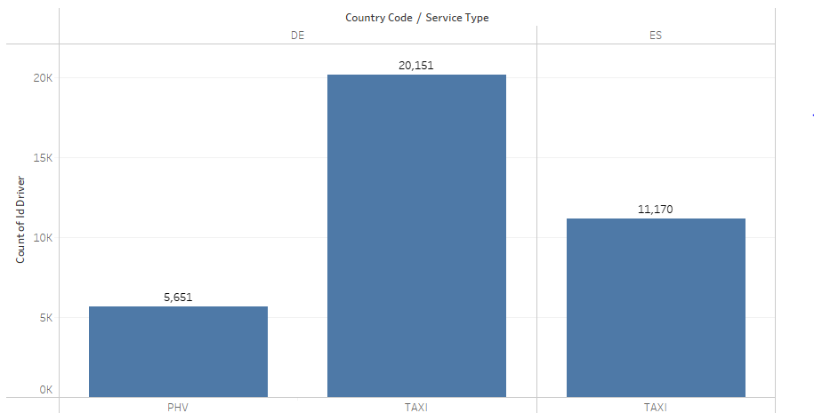
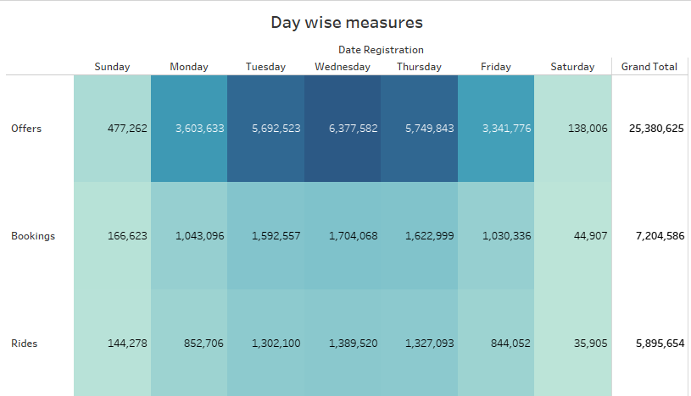
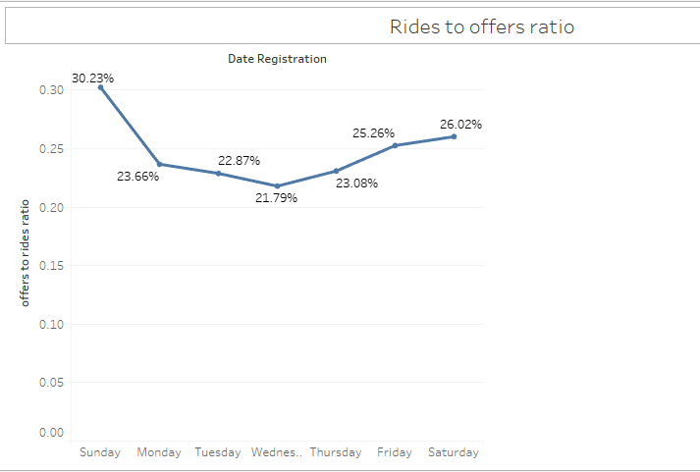
Trends and Insights
Almost 85% drivers have chosen taxi.
Mostly Tue, wed, Thursdays are with high demand.
20-30% offers are converted to rides.
But almost 82% of bookings are into rides.
Sat and Sunday’s have seen highest rides ratio.
Only Germany drivers opted to PHV Services.

Slide 5
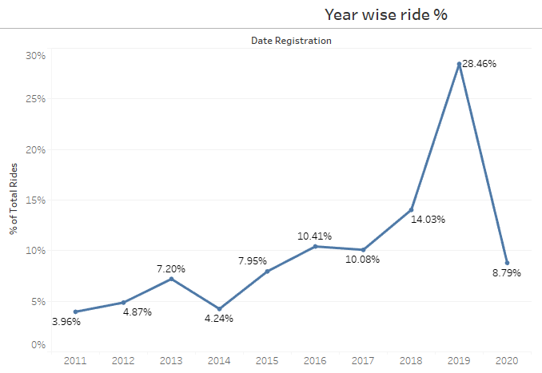
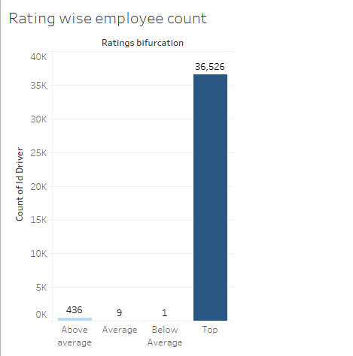
Trends and Patterns
Quick rides % drop from 2019(28.46%) to 2020(8.79%)
May be due to covid 19.
Lowest rides are in 2011.
Almost 99% drivers are in top ratings indicates a good sign.
Only 10 drivers are with less ratings.

Slide 6
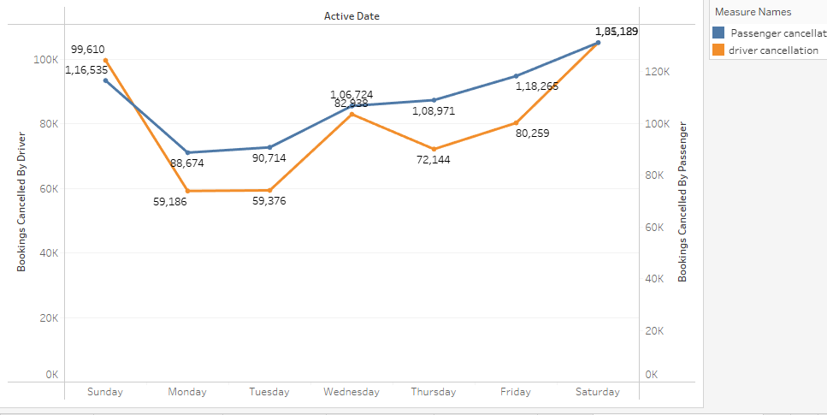
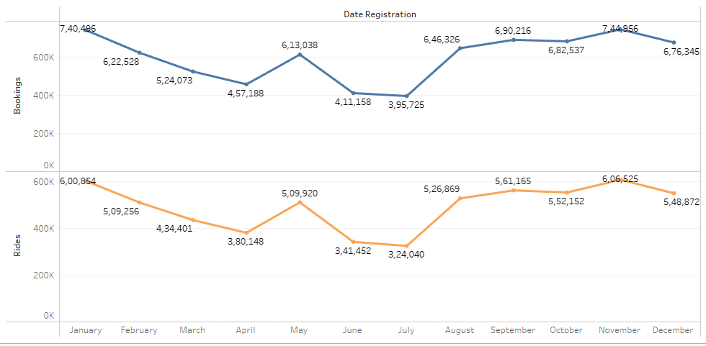
Bookings and Cancellation Trends
Passengers cancellations are more compared to
drivers cancellation.
Weekend cancellations are more compared to weekdays.
June and July have seen less bookings.
Jan and Nov have highest bookings record.

Slide 7
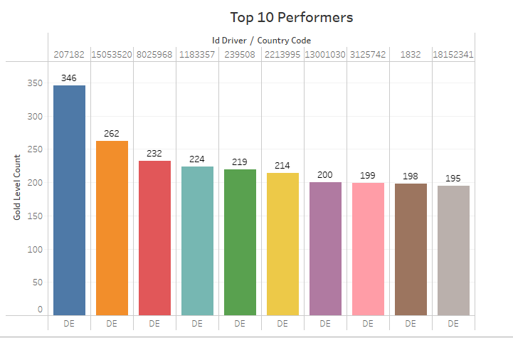
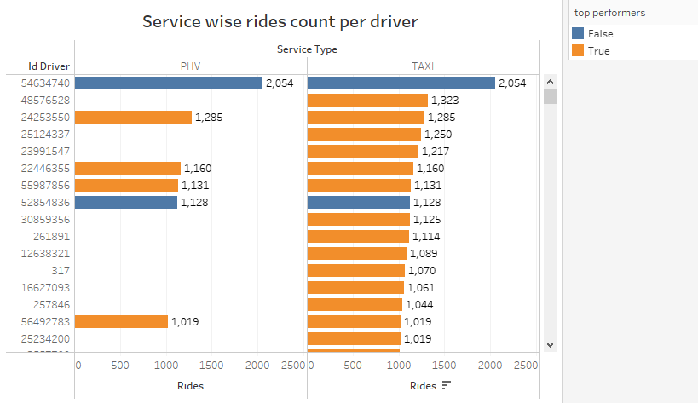
Top Drivers
These are top 10 drivers in gold level count.
We can see all are from Germany.
Few Drivers rides both taxi and PHV.
Driver with highest rides count not into gold level
count.

Slide 8
Recommendations
Connect with drivers with less ratings to find out the challenges and resolve accordingly.
Reward the drivers with more ratings for boosting to maintain consistent rides.
Motivate the drivers for opting marketing services and let them know the benefits among them.
Campaign in Spain for more drivers as we see less driver count in Spain.
Connect with the drivers with highest rides and not into gold level count to know the challenges.
Offer seasonal rewards for drivers to be more active on weekends and Occasionals.
Take behavioral sessions for drivers if required for better user interaction.
Make strict cancellation policies to avoid more cancellations.

Slide 9
Thank you

